Slide 1
Logic Design
100110100010011…

Slide 2
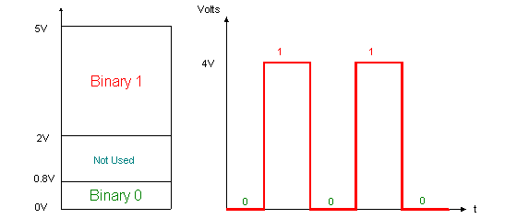
The Basics of Logic Design
The electronics inside a modern computer are digital.
Digital electronics operate with only two voltage levels of interest: a high voltage and a low voltage.
All other voltage values are temporary and occur while transitioning between he values.
Notes:
The fact that computers are digital is also a key reason they use binary numbers, since a binary system matches the underlying abstraction inherent in the electronics.
Also, using decimal value would have been much more costly (more logic to distinguish 10 different levels)

Slide 3
The Basics of Logic Design
Rather than refer to the voltage levels, we talk about signals that are:
(logically) true, or 1, or are asserted
(logically) false, or 0, or are deasserted
Notes:
The fact that computers are digital is also a key reason they use binary numbers, since a binary system matches the underlying abstraction inherent in the electronics.

Slide 4
The Basics of Logic Design
Logic blocks are categorized as one of two types, depending on whether they contain memory.
Blocks without memory (called combinational)
The output of a combinational block depends only on the current input.
Blocks with memory
The outputs can depend on both the inputs and the value stored in memory, which is called the state of the logic block.
We will focus only on combinational logic.

Slide 5
The Truth Table

Slide 6
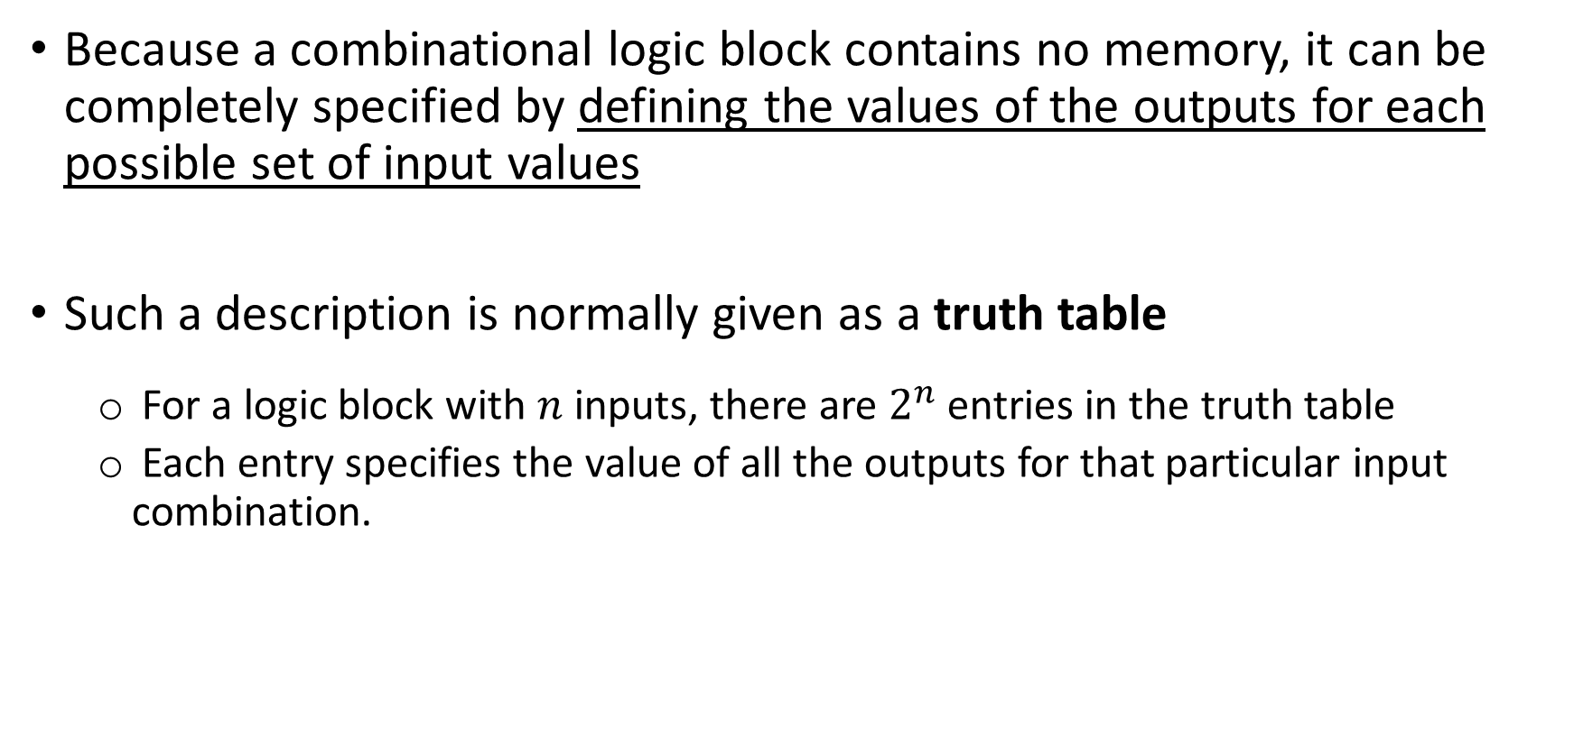
The Truth Table
Because a combinational logic block contains no memory, it can be completely specified by defining the values of the outputs for each possible set of input values
Such a description is normally given as a truth table
For a logic block with $n$ inputs, there are $2^{n}$ entries in the truth table
Each entry specifies the value of all the outputs for that particular input combination.

Slide 7
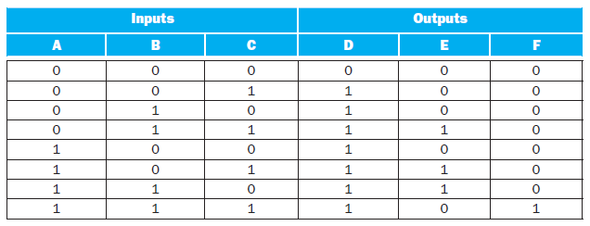
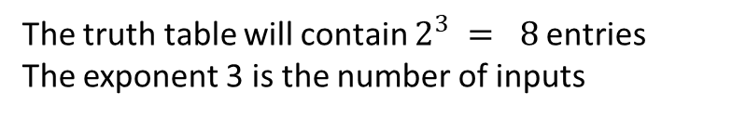
The truth table will contain $2^{3} = 8$entries
The exponent 3 is the number of inputs
There are three different, and independent, output based on these 3 three inputs.
Notes:
Note that:
D = A + B + C
F = A * B * C
What about E?

Slide 8
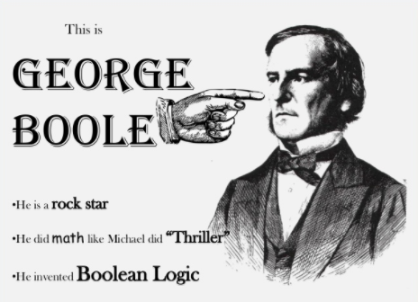
Another approach is to express the logic function with logic equations. This is done with the use of Boolean algebra
In Boolean algebra, all the variables have the values 0 or 1 and, in typical formulations, there are three operators
Notes:
George Boole, if you want to know, was an English mathematician born in 1815

Slide 9
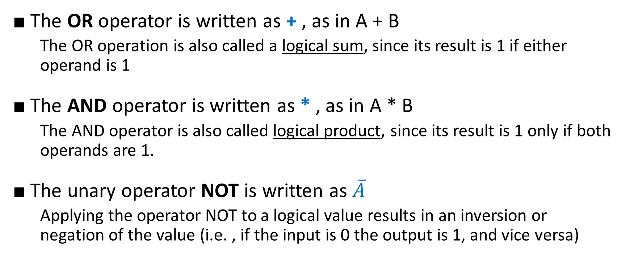
Boolean Algebra
■ The OR operator is written as + , as in A + B
The OR operation is also called a logical sum, since its result is 1 if either operand is 1
■ The AND operator is written as * , as in A * B
The AND operator is also called logical product, since its result is 1 only if both operands are 1.
■ The unary operator NOT is written as $\overline{A}$
Applying the operator NOT to a logical value results in an inversion or negation of the value (i.e. , if the input is 0 the output is 1, and vice versa)

Slide 10
EXERCISE: Show the logic equations for the logic functions, D, E, and F
D = A + B + C

Slide 11
EXERCISE: Show the logic equations for the logic functions, D, E, and F
F = A * B * C

Slide 12
EXERCISE: Show the logic equations for the logic functions, D, E, and F
$$E=\left(A ∗B∗\overline{C}\right)+ \left(A∗\overline{B }∗C\right)+ (\overline{A}∗B∗C)$$
Another representation
$$E= \left( \left(A∗ B\right)+ \left(A∗ C\right)+ \left(B∗ C\right) \right)+(\overline{A∗B∗C})$$
Notes:
E is a little tricky. Think of it in two parts: what must be true for E to be true (two of the three inputs must be true), and what cannot be true (all three cannot be true).

Slide 13

Gates

Slide 14

Gates
Logic blocks are built from gates that implement basic logic functions.
Since both AND and OR are commutative and associative, an AND or an OR gate can have multiple inputs, with the output equal to the AND or OR of all the inputs.
AND
OR
NOT
The logical function NOT is implemented with an inverter that always has a single input.
Notes:
AND, OR, INVERTER

Slide 15



Gates
What logic function is represented here?
The function $\overline{\overline{A}+B}$, using explicit inverters on the left and bubbled inputs and outputs on the right.
Rather than draw inverters explicitly, a common practice is to add “bubbles” to the inputs or outputs of a gate to cause the logic value on that input line or output line to be inverted.

Slide 16
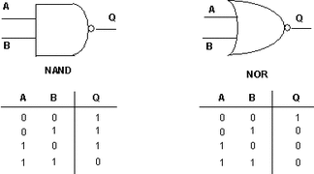
Gates
There are also two common inverting gates called NOR and NAND and correspond to inverted OR and AND gates, respectively.
NOR and NAND gates are called universal, since any logic function can be built using this one gate type.
Notes:
Any logical function can be constructed using AND gates, OR gates, and inversion.
Actually, all logic functions can be constructed with only a single gate type, if that gate is inverting (NAND or NOR)

Slide 17
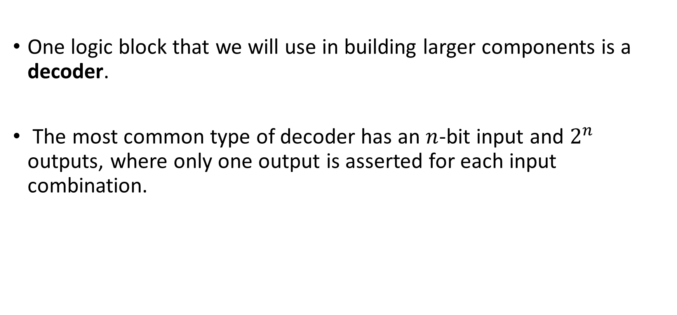
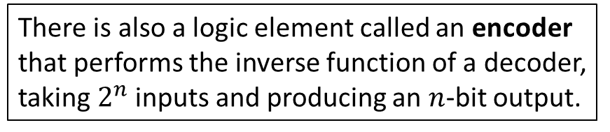
Combinational Logic
One logic block that we will use in building larger components is a decoder.
The most common type of decoder has an $n$-bit input and $2^{n}$ outputs, where only one output is asserted for each input combination.
There is also a logic element called an encoder that performs the inverse function of a decoder, taking$2^{n}$inputs and producing an $n$-bit output.

Slide 18
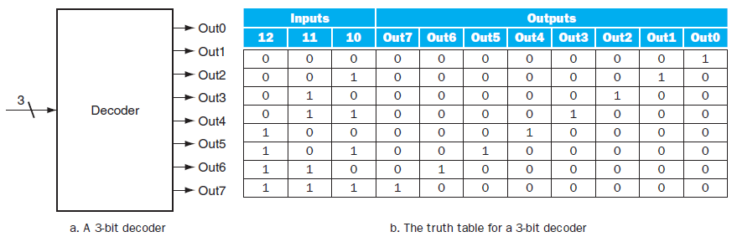
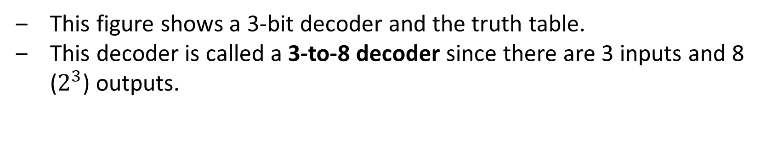
This figure shows a 3-bit decoder and the truth table.
This decoder is called a 3-to-8 decoder since there are 3 inputs and 8 ($2^{3}$) outputs.

Slide 19
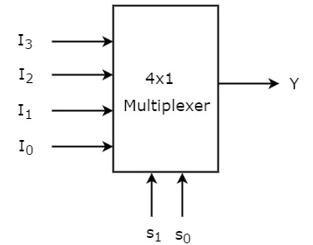

Multiplexor
A multiplexor might more properly be called a selector, since its output is one of the inputs that is selected by a control.
Multiplexors can be created with an arbitrary number of data inputs.
When there are only two inputs, the selector is a single signal that selects one of the inputs if it is true (1) and the other if it is false (0).
In the picture we have two signals $S_{1}$and $S_{0}$ capable to select one of the 4 ($2^{2}$) input signals

Slide 20
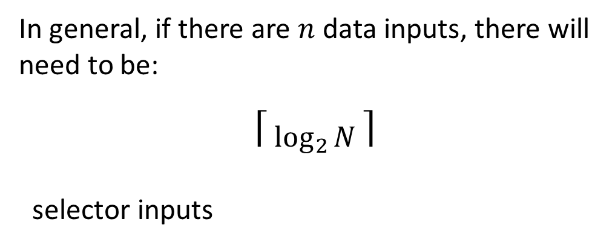
Multiplexor
A multiplexor might more properly be called a selector, since its output is one of the inputs that is selected by a control.
In general, if there are $n$ data inputs, there will need to be:
⎡ $\log_{2}{N}$⎤
selector inputs

Slide 21
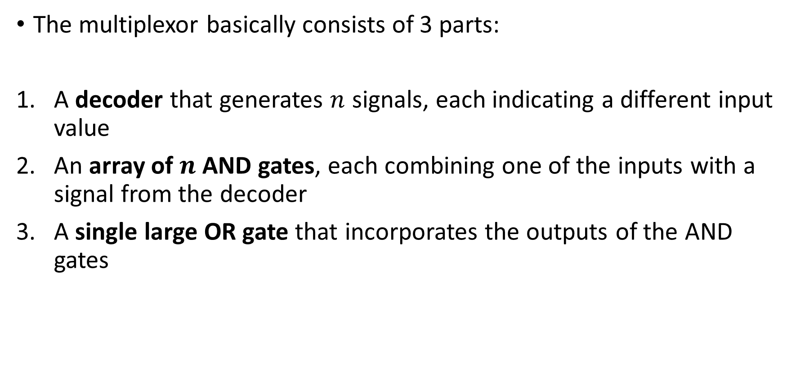
Multiplexor
The multiplexor basically consists of 3 parts:
A decoder that generates $n$ signals, each indicating a different input value
An array of $n$ AND gates, each combining one of the inputs with a signal from the decoder
A single large OR gate that incorporates the outputs of the AND gates

Slide 22
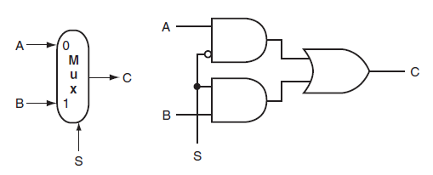
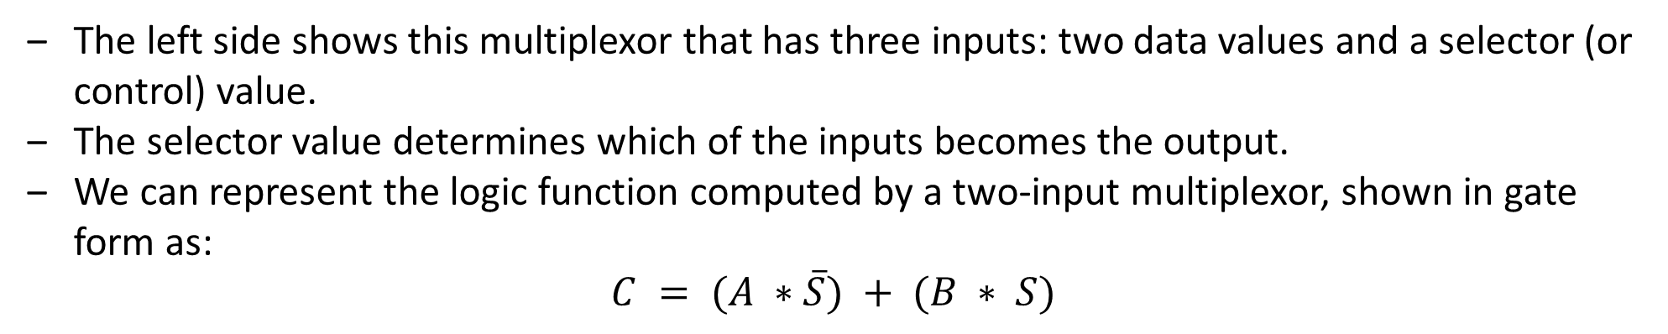
The left side shows this multiplexor that has three inputs: two data values and a selector (or control) value.
The selector value determines which of the inputs becomes the output.
We can represent the logic function computed by a two-input multiplexor, shown in gate form as:
$$C = (A ∗\overline{S}) + (B ∗ S)$$

Slide 23
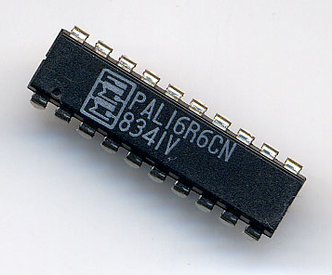
Two-level Logic and Programmable Logic Arrays
Notes:
Sometimes also called PAL as you can see in the picture (a PAL from Monolithic Memories, that invented them in 1978)

Slide 24
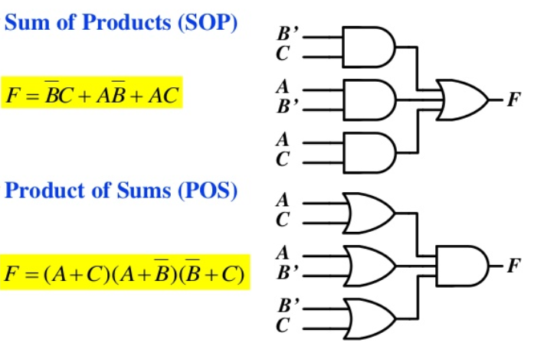
Two-level logic
Any logic function can be written in a canonical form, where every input is either a true or complemented variable and there are only two levels of gates: one being AND and the other OR
Such a representation is called a two-level representation, and there are two forms, called sum of products and product of sums

Slide 25

$$E=\left(A ∗B∗\overline{C}\right)+ \left(A ∗C∗\overline{B}\right)+ (B∗ C∗\overline{A})$$
This equation is in a sum-of-products form: it has two levels of logic and the only inversions are on individual variables.

Slide 26
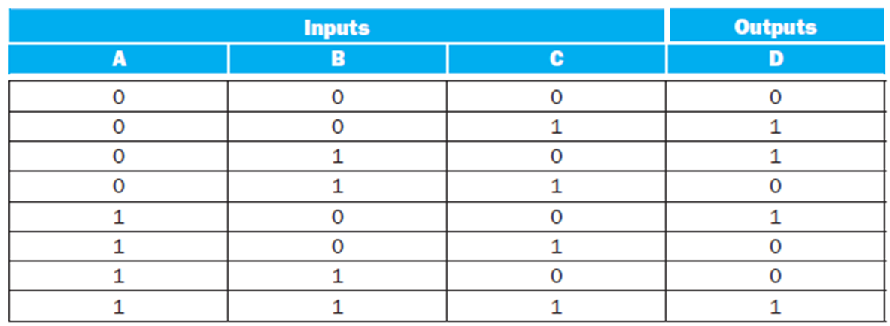

From truth table to sum of products
1
2
3
4
1
2
$$D=\left(\overline{A} ∗\overline{B}∗C\right)+ \left(\overline{A} ∗B∗\overline{C}\right)+ \left(A∗ \overline{B}∗\overline{C}\right)+(A∗B∗C)$$
3
4
Notes:
Each truth table entry for which the function is true corresponds to a product term.
The product term consists of a logical product of all the inputs or the complements of the inputs, depending on whether the entry in the truth table has a 0 or 1 corresponding to this variable.
The logic function is the logical sum of the product terms where the function is true.

Slide 27
PLAs (programmable sum-of-products)
The sum-of-products representation corresponds to a common structured-logic implementation called a programmable logic array (PLA).
A PLA has a set of inputs and corresponding input complements (which can be implemented with a set of inverters), and two stages of logic
The first stage is an array of AND gates that form a set of product terms (sometimes called minterms)
Each product term can consist of any of the inputs or their complements.
The second stage is an array of OR gates, each of which forms a logical sum of any number of the product terms.

Slide 28
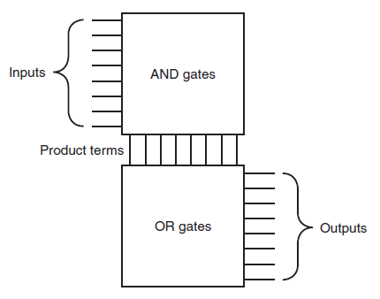
Notes:
A PLA

Slide 29
PLAs
A PLA can directly implement the truth table of a set of logic functions with multiple inputs and outputs.
The number of AND gates is due to the rows in the truth table where AT LEAST ONE of the output is 1
Each output corresponds to a potential row of OR gates in the second stage.

Slide 30
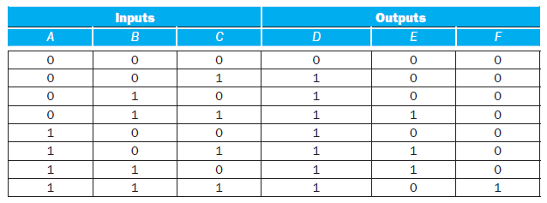
Since there are 7 unique product terms with at least one true value in the output section, there will be 7 columns in the AND plane
The number of rows in the AND plane is 3 (since there are 3 inputs), and there are also 3 rows in the OR plane (since there are 3 outputs).

Slide 31
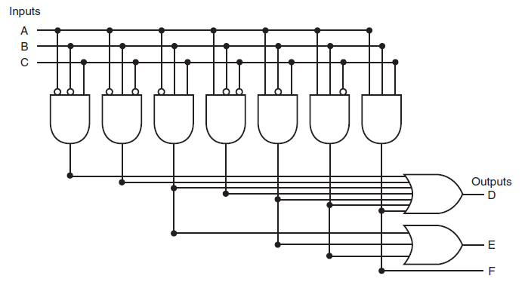
D = A + B + C
$$E=\left(A ∗B∗\overline{C}\right)+ \left(A∗\overline{B }∗C\right)+ (\overline{A}∗B∗C)$$
F = A * B * C
Notes:
The «not»s corresond to the 0 in the truth table
The inputs in the OR are the 1 in the output table

Slide 32
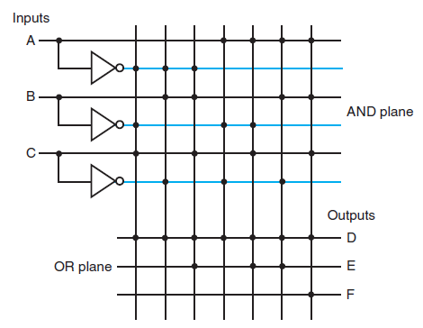

Slide 33
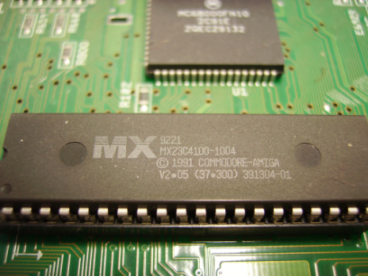
ROM
Notes:
In the picture you see a ROM containing the “kickstart” (version 2.5) for a Commodore Amiga computer

Slide 34
ROMs
Another form of structured logic that can be used to implement a set of logic functions is a read-only memory (ROM).
A ROM is called a memory because it has a set of locations that can be read; however, the contents of these locations are fixed, usually at the time the ROM is manufactured.
There are also programmable ROMs (PROM) that can be programmed electronically, when a designer knows their contents.
There are also erasable PROMs (EPROM); these devices require a slow erasure process using ultraviolet light, and thus are used as read-only memories, except during the design and debugging process.

Slide 35
ROMs
ROMs and PLAs are closely related.
A ROM is fully decoded: it contains a full output word for every possible input combination.
A PLA is only partially decoded.
For the earlier truth table, the ROM contains entries for all 8 possible inputs, whereas the PLA contains only the seven active product terms.
Notes:
This means that a ROM will always contain more entries.

Slide 36
ROMs
As the number of inputs grows, the number of entries in the ROM grows exponentially.
This difference makes PLAs generally more efficient for implementing combinational logic functions.
So why ROM?
ROMs have the advantage of being able to implement any logic function with the matching number of inputs and outputs.
This advantage makes it easier to change the ROM contents if the logic function changes, since the size of the ROM need not change.

Slide 37

Don’t cares

Slide 38
Don’t cares
Often in implementing some combinational logic, there are situations where we do not care what the value of some output is
Either because another output is true
Or because a subset of the input combinations determines the values of the outputs
Such situations are referred to as don’t cares
Don’t cares are important because they make it easier to optimize the implementation of a logic function
They are useful to simplify the logic for a PLAs, but not useful for ROMs (in fact, you have all the lines anyway…)

Slide 39
Don’t cares
There are two types of don’t cares:
Output don’t cares and input don’t cares
Output don’t cares arise when we don’t care about the value of an output for some input combination.
They appear as Xs in the output portion of a truth table.
Input don’t cares arise when an output depends on only some of the inputs
They are also shown as Xs, though in the input portion of the truth table.

Slide 40
Don’t cares - Exercise
Consider a logic function with inputs A, B, and C defined as follows:
If A or C is true, then output D is true, whatever the value of B
If A or B is true, then output E is true, whatever the value of C
Output F is true if exactly one of the inputs is true, although we don’t care about the value of F, whenever D and E are both true.
Show the full truth table for this function and the truth table using don’t cares.

Slide 41
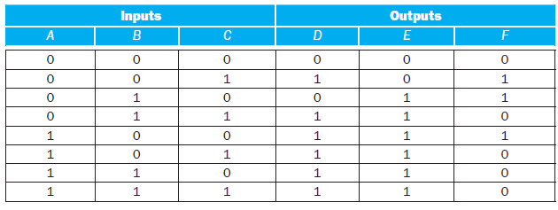
This requires seven product terms without optimization.
Output F is true if exactly one of the inputs is true, although we don’t care about the value of F, whenever D and E are both true.
Notes:
Here’s the full truth table, without don’t cares

Slide 42
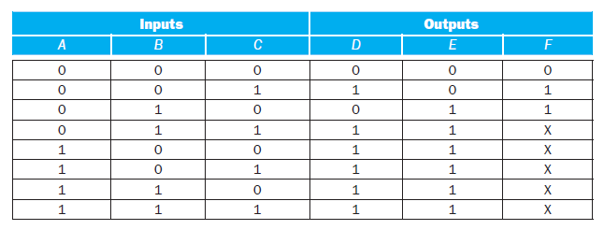
output don’t cares
Notes:
The truth table written with output don’t cares looks like this

Slide 43
If A or C is true, then output D is true, whatever the value of B.
Notes:
The truth table written with output don’t cares looks like this

Slide 44
If A or B is true, then output E is true, whatever the value of C.
Notes:
The truth table written with output don’t cares looks like this

Slide 45
X 1 1
1 X X
Notes:
The truth table written with output don’t cares looks like this

Slide 46
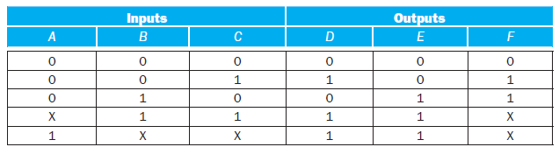
If A or C is true, then output D is true, whatever the value of B
If A or B is true, then output E is true, whatever the value of C
Output F is true if exactly one of the inputs is true, although we don’t care about the value of F, whenever D and E are both true.
Notes:
If we also use the input don’t cares, this truth table can be further simplified to yield the following

